Slide 1
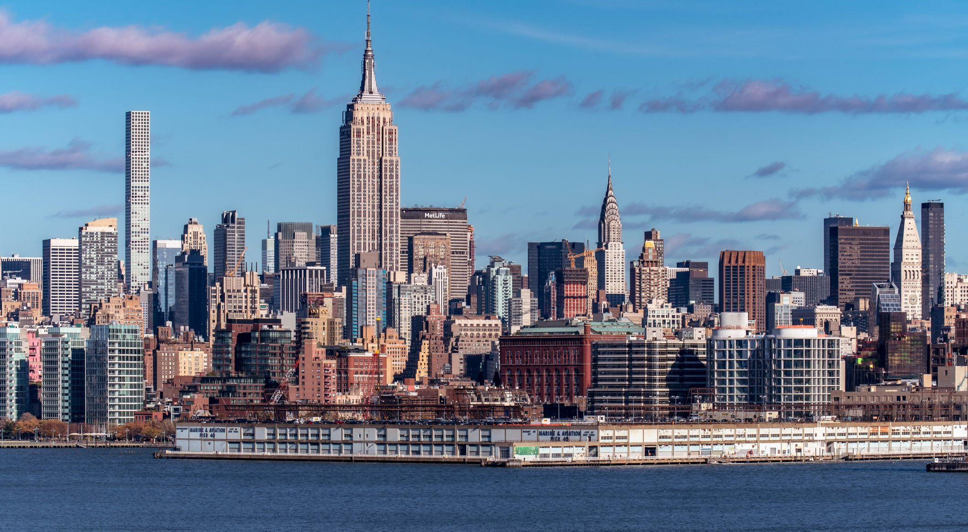
Identifying Uber Demands for NYC
DS 501 CASE STUDY 3
GROUP 10 :
Soumya Joshi Vandana Anand
Manasi Shrotri Kratika Agrawal

Slide 2

Problem Statement
Motivation
Uber is a popular ride-sharing company and makes innumerable rides everyday across the United States, especially in New York.
However, some areas are frequently packed with uber vehicles while other places are not
Demand varies based on Weekday and Hour of the day.
Importance
Omportance

Slide 3
Steps in identifying Uber demands :
Gathering Uber Pickup data
We have gathered uber data for six months and performed data exploration.
1
Most popular pickup Locations
We have used clustering to identify 10 most popular pickup Locations in NYC.
2
High demanding days and hours for Uber
For the most popular pickup location we have found the peak days and hours for uber.
3

Slide 4
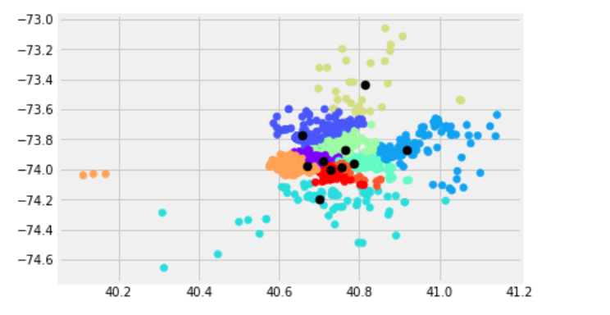
Using K means function in Sklearn library in python.
10 Cluster Centroids (K = 10)
In the graph, the black dots represent the final K centroids predicted by the K means.
The K Clusters show 10 areas in NYC with the highest Uber demands.
K means Clustering :

Slide 5

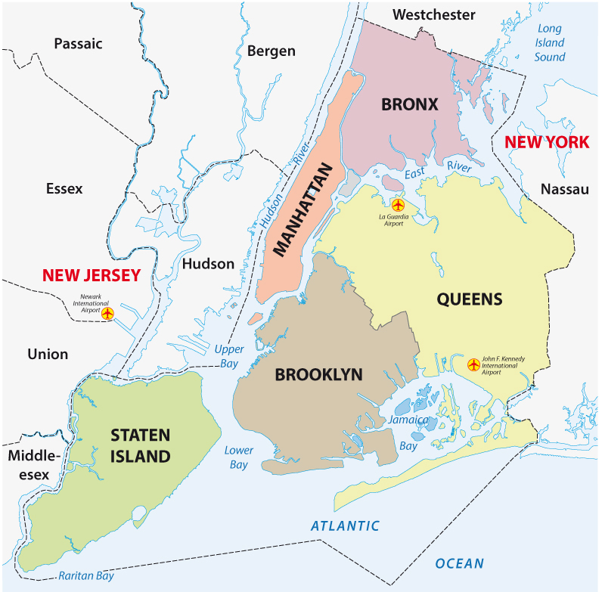
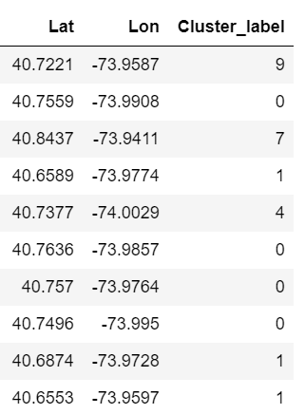
Problem Statement
Borough identification with clustering
Manhattan
Brooklyn
Bayswater,Queens
Marriott Laguardia Airport, Queens
Laguardia Place, Manhattan
Harvest Drive, Westchester
Newark, New Jersey
5th Ave, Manhattan
Suffolk country
Kings, NY

Slide 6
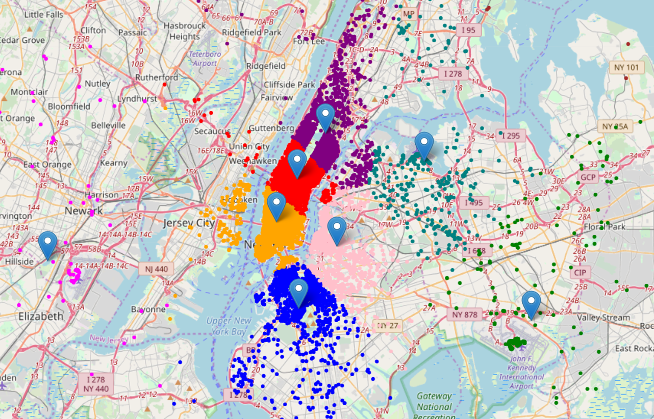
Problem Statement
Map Visualization of Uber major locations with Folium

Slide 7
Problem Statement
Demand Count of identified K-means clusters
Manhattan
Brooklyn
New Jersey

Slide 8
Problem Statement
Hierarchical clustering for sub locations
Manhatten part1
Brooklyn
Queens
Manhatten part2
NYC
New Jersey
Suffolk
5ht Ave Manhatten
Kings
Westchester

Slide 9
Problem Statement
Hierarchical clustering for sub locations
Manhattan part1
Brooklyn
Queens
Manhattan part2
NYC
New Jersey
Suffolk
5ht Ave Manhattan
Kings
Westchester

Slide 10
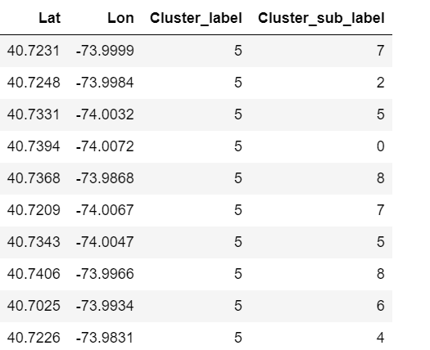
Problem Statement
Hierarchical clustering for sub locations
Bowery
Cortlandt Street
Manhattan part1
9th Avenue
Brooklyn
Cortlandt Street
Queens
Bleecker Street
Manhattan part2
Christopher Columbus Drive
NYC
New Jersey
East 16th Street
Suffolk
Adams Street
5ht Ave Manhattan
East 9th Street
Kings
Canal Street
Westchester
Grand Street

Slide 11
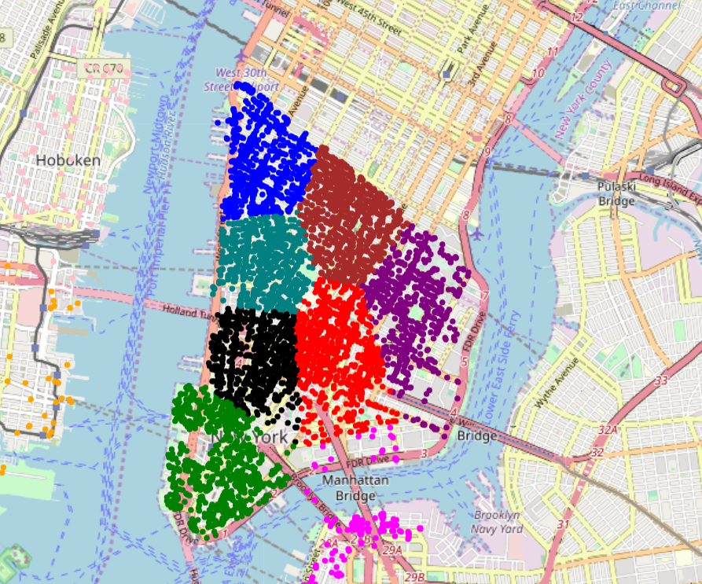
Problem Statement
Map Visualization of Sub-location

Slide 12
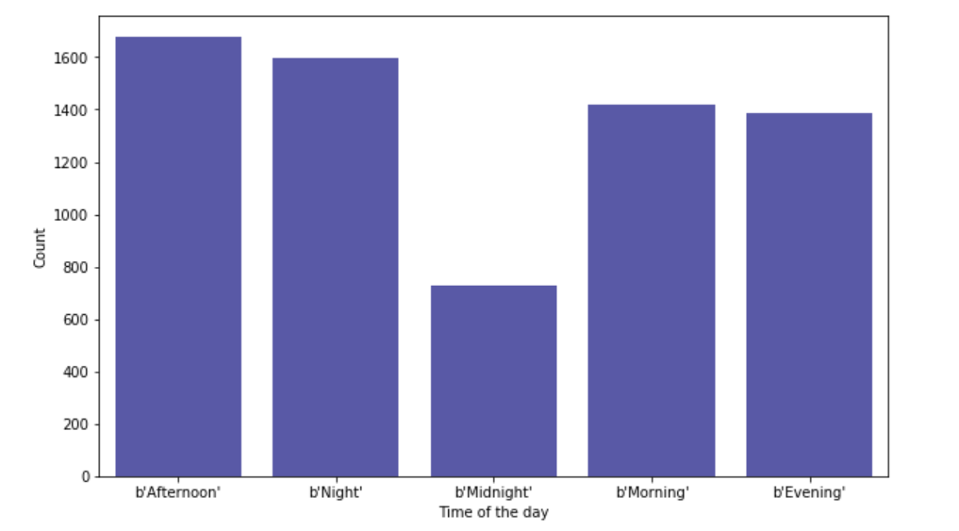
Problem Statement
Time distribution of Uber pickups in Manhattan

Slide 13
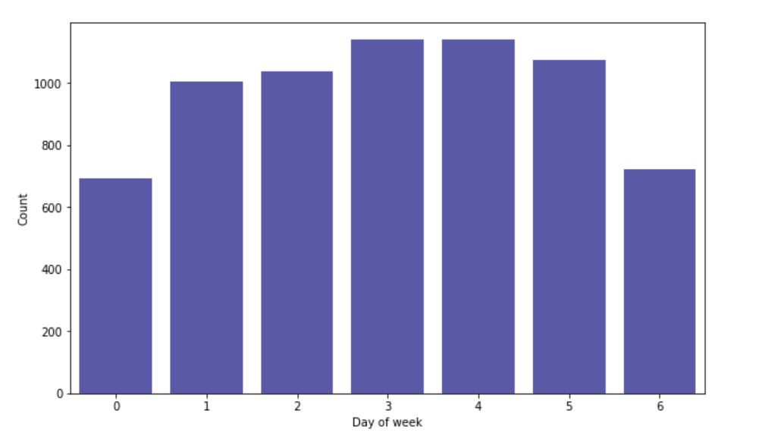
Problem Statement
Day distribution of Uber pickups in Manhattan
THURSDAY
SATURDAY
WEDNESDAY
FRIDAY
TUESDAY
MONDAY
SUNDAY

Slide 14
Problem Statement
Conclusion
As identified by the Model, people in Manhattan request Uber too frequently.
Uber must install more cabs in the area in order to meet the high demand.
Thursdays & Fridays are busiest days for Uber.
Need more frequent cabs on these days.
Afternoon & Night demand more Uber rides.
People take cabs for offices, night parties. Need higher Uber service during these peak hours.

